Slide 1

EEE1024: Fundamentals of Electrical and
Electronics Engineering
Dr. Sanchit Khatavkar

Slide 2

THEVENIN’S Theorem
MAXIMUM POWER TRANSFER

Slide 3

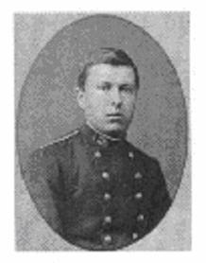
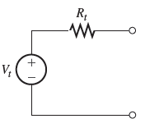
Thevenin Equivalent Circuit
Network can be replaced by an equivalent network consisting of a voltage source V_{t} connected in series with a resistor R_{t}
What is V_{t} and R_{t}?
V_{t} – Open Circuit voltage at the terminals
R_{t} – Input/ equivalent resistance at the terminals
when sources (independent) are turned off
a
+
Network
VARIABLE
Load
R
FIXED
-
b
a
+
Black box
Load
R
-
b

Slide 4
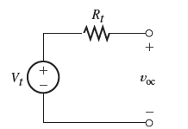
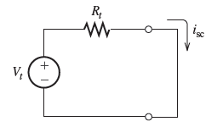

Thevenin Equivalent Circuit
Open-Circuit terminals
Short-Circuit terminals
Black box
Black box
No current flows through this circuit
Current flows through this circuit & voltage across terminals is zero

Slide 5
Finding Thevenin Resistance Directly
Zeroing a voltage source
Reduce voltage to zero
Zeroing method!
SHORT-CIRCUIT
Zeroing a current source
Reduce current to zero
OPEN-CIRCUIT

Slide 6
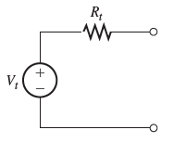
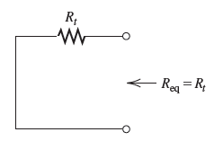
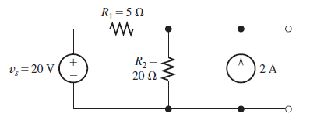
Finding Thevenin Resistance Directly
Thevenin equivalent:
Original network
After Zeroing
To find Rt;
Zero sources in orginal
Compute R between terminals
Example 1: Find Thevenin resistance, short circuit current and Thevenin equivalent circuit for the
circuit shown below

Slide 7
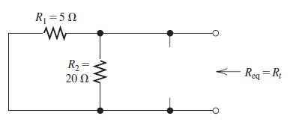

Thevenin Resistance – Example 1
Original circuit
Voltage source – short circuit
Current source – open circuit
Circuit with sources zeroed

Slide 8
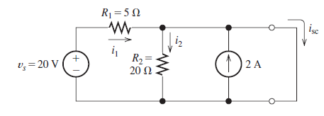



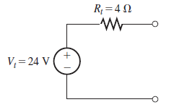

Thevenin Equivalent Circuit – Example 1
In short circuit,
V across R₂ = 0 =>
I through R₂ = 0
i₂ = 0
V_{R1} = 20V
KCL @ Node joining top ends of R₂ and 2A source
Notes:
https://vitacin-my.sharepoint.com/personal/sanchit_khatavkar_vit_ac_in/_layouts/15/Doc.aspx?sourcedoc={6de2cc0e-234d-4bb7-ada1-8aefc5ac2dad}&action=edit&wd=target%28English.one%7C66c35f06-ad80-415a-aa37-bab46b03c81f%2FClass%20Notes%7C4ccd250d-6148-4edd-89b5-24834dca7f4a%2F%29

Slide 9
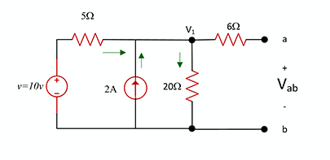
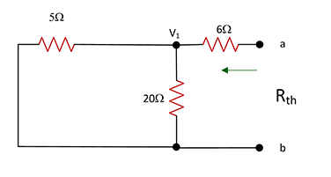
Thevenin Equivalent Circuit – Example 2
Q) Find Thevenin voltage and Thevenin resistance
Node voltage analysis can also be used – 2 times (for OC and SC)
Step 1: V source – short, I source - open
Step 2: Use node analysis at V₁ to get V_{t}

Slide 10
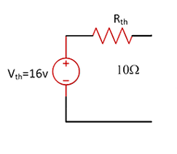


Thevenin Equivalent Circuit – Example 2
Q) Find Thevenin voltage and Thevenin resistance
Step 2: Use node analysis at V₁ to get V_{t}

Slide 11

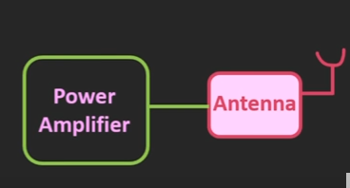
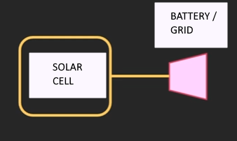
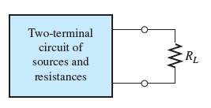
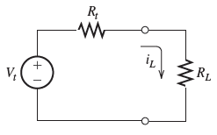
MAXIMUM POWER TRANSFER
LOAD Resistor

Slide 12





MAXIMUM POWER TRANSFER
Goal: Maximum power has to be delivered to the load!
Short circuited Thevenin Equivalent Circuit WITH LOAD
R_{t} and R_{L} are in series
What value of R_{L} will ensure that maximum power is delivered from the Thevenin Eq. Ckt.??
Power delivered to the load
Substituting for i_{L}
R_{L} = R_{t} !!

Slide 13

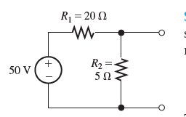

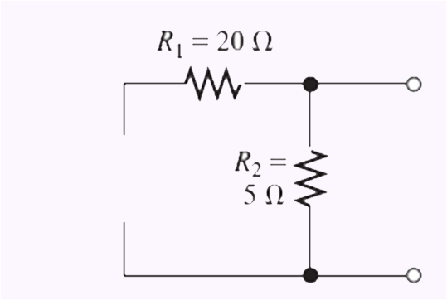


MAXIMUM POWER TRANSFER - Example
Find load resistance for maximum power transfer from the circuit shown.
Also find the maximum power.
KCL @ V_{oc}
V_{oc}
+
V_{oc}
-

Slide 14
Acknowledgements
www.allaboutelctronics.org
H. Hayt, J.E. Kemmerly and S. M. Durbin, ‘Engineering Circuit Analysis’, 6/e, Tata McGraw Hill, New Delhi, 2011
Allan R. Hambley, ‘Electrical Engineering - Principles & Applications, Pearson Education, First Impression, 6/e, 2013

